Slide 1
Amazon Web Services IoT & AWS IoT for the Edge
Jelena Jakimov 16106

Slide 2

Internet of Things
The Internet of things (IoT) is a system of interrelated computing devices, mechanical and digital machines provided with unique identifiers (UIDs) and the ability to transfer data over a network without requiring human-to-human or human-to-computer interaction.

Slide 3
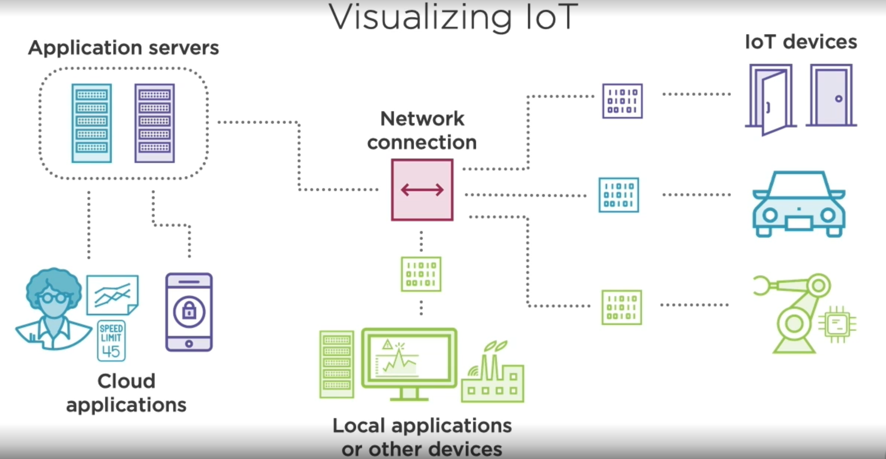
Visualizing of IoT
IoT devices, traditionally non-network devices, send a bits of information and because of that they might be networked in some way ,e.g. with a local application or a local device, or directly connected to some remote servers.

Slide 4
AWS IoT thing
smart/connected devices - things (like smart watches, thermostats, dishwashers…)
‘AWS IoT thing- A representation of a specific device or logical entity.‘ (not only physical device)
In other words, it can be an application instance or physical entity related to devices that connect to AWS IoT but don't connect to themselves
Example- in the context of smart car it could be an engine which is surely physical part of the car, but it sends bits of information to a smart car, it is not connected to AWS directly.

Slide 5
Purpose of IoT things
Data collection – a truck that constantly sends GPS coordinates
Device interaction – a lightbulb allowing control over the color and brightness
Both – a thermostat that reads the temperature and allows remote changes to heating or AC settings

Slide 6
Comparing AWS IoT to Self-managed IoT
IoT is complex, there is a lot of different parts that are moving around in order to create secure and useful IoT system for our organization.
And AWS is going to simplify a lot of this by taking some of this responsibilities on themselves and allowing us to leverage their services without having to do it all ourselves

Slide 7
But, how AWS does this?
By providing us serverless IoT platform
What serverless means actually?
Infrastructure scales with requirements and you pay for what you use
You can focus on application code and developing new products rather than having to manage your own infrastructure
Code is triggered by different events and this just prevents the code that you write from just running idly all the time
Instead you're just paying for the code that's actually running in the given moment when it's triggered by event
Providing services related to security, AWS offers more adventage for IoT apps. Authentication, permission, managingcertificates and monitoring and logging would become a significant burden in your own environments.

Slide 8
In AWS you get this all out of box, integrated directly and easily with your IoT apps!
Let’s dive into details…

Slide 9
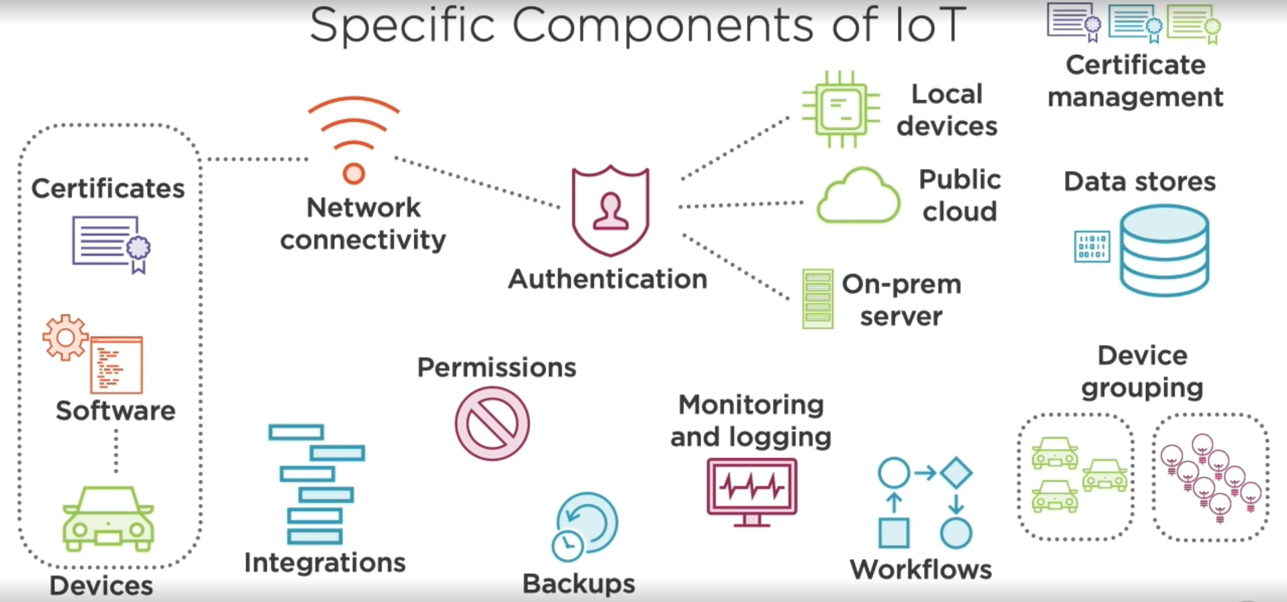
How does AWS fit in with IoT needs?
In order to start working with IoT devices effectively, we should need following kind of things:

Slide 10
How does AWS fit in with IoT needs? -Devices
Devices and certificates:
We need to verify these devices through some sort of authorization provider so we know these devices are who they say they are. AWS provides authorization, authentication and certificate management system for this purposes.
Device and device software:
AWS offers different tools for this purposes, but in general, device software is some kind on lightweight operating systems which allows you to interface more effectively.

Slide 11
How does AWS fit in with IoT needs? -Security management systems
Authentication management system - authenticate certificates and then maybe pass them on to a public cloud or local devices
Certificate management system – provides certificates for every device - IoT thing, takes care of the expiration date, renewal etc.
Permissions management system - checks if device that is sending information is allowed to send to the public cloud or local devices

Slide 12
How does AWS fit in with IoT needs? -Down the line with our needs
Integrations - we might want to integrate devices or the data that's coming in with other apps or third party APIs
Workflows - we might have workflows that we want to integrate into our systems so that if something happens on a device we can trigger other actions happen

Slide 13
How does AWS fit in with IoT needs? -More security
Monitoring and logging - we might want to monitor and log our device states to see if there's anything unusual happening
Backup - we might want to do backups of data that's coming in or the devices and the states they're in, so we can return to previous state in case of

Slide 14
AWS solutions -Device software
AWS offers different tools and one of them is Amazon FreeRTOS.
An open-source piece of software that you can integrate with your devices allowing them to be used more effectively
AWS provides also an AWS IoT Device SDK, in multiple programming languages for programming IoT devices that need to interact with the AWS cloud services

Slide 15
AWS solutions -Device software (GREENGRASS)
AWS IoT Greengrass - allows you to extend AWS services down into your own devices, so rather then having all of your devices need to connect up into the cloud, you can extend the functionality of AWS services down into your own hardware in your own, maybe manufactoring environment or other locations that need some sort of ability to use things like AWS services, but don't always get to connect to the Internet
So this can really expand the amount of things you can do with those devices.

Slide 16
AWS solutions - Thing registry
Allow you to register all devices you have so that you can keep track of them, search them, use certificates of them, group them and add useful metadata
Thing registry gathers things, thing-types or thing-groups.
A car could be the thing, different types of car could be thing-types, such as electric car, sport car etc. A group of cars with the same attribute could be the thing-group, e.g. all cars with seat-warmers embedded.

Slide 17
AWS solutions - Thing registry
Thing atributes
searchable attributes are defined for all things (max 3) Things can be queried by these parameters.
in our example it would be a year of production, or number of horsepower
non-searchable attributes are defined for thing-types (max 50) and refers to a metadata of the thing-types
Number of thing-types is unlimited.

Slide 18
AWS solutions - Thing registry
Thing Groups
Groups gather things or other thing-groups.
One thing can be related to maximum 10 thing-groups.
Groups are used for:
updating multiple devices at the same time
separating things with exclusive attributes
certifying and permitting multiple devices at the same time

Slide 19
AWS solutions - Thing registry
Dynamic groups
Groups can also be created dynamically, when a certain condition is satisfied.
Dynamic groups are based on current value of some attribute, and will exist until there is a need for that.
Example
Grouping devices which have a battery level above 50%, in a moment when we have a need for that.
Battery level is a time variable, but we rely on the moment of creating.

Slide 20
AWS solutions -AWS device defender
‘An IoT security service that allows tou to audit the configuration of your devices, monitor connected devices to detect abnormal behavior, and to mitigate security risks.’
Features:
Audit – run a set of predefined checks to look for best practices with IoT things and other configuration in AWS account.
Detect – used to detect anomalies that you configure and define

Slide 21
AWS solutions -AWS device defender
Audit
Revoked certificates
Overly permissive policies
Expiring certificates
Devices reusing certificates to connect
Disabled logging
Detect
Configuring black and white IP lists
Spikes in in/outbound traffic
Spikes in number of messages or message size
Number of authorization failures
Unusual port listening activity
Number of active connections
Number of connection attempts

Slide 22
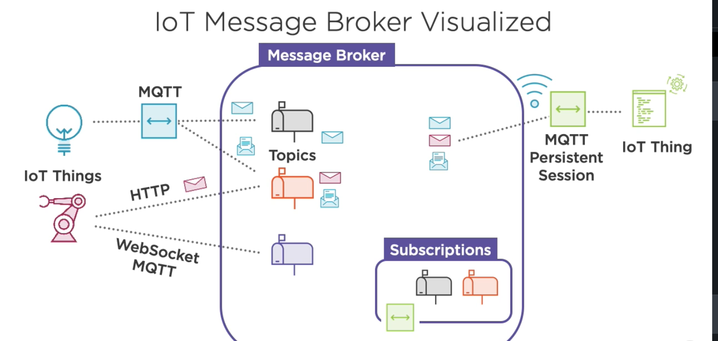
AWS solutions -Message broker
‘A publish/subscribe broker service that enables the sending and receiving of messages to and from AWS IoT.’

Slide 23
AWS solutions -Message broker
IoT things connect to topics through different connection methods (MQTT, HTTP, WebSockets) and send data to them.
On the other side, there is an IoT thing (probably an application), as a subscriber to the topics, establishing persistent MQTT session. It is going to receive messages from the topic and process them inside of the application and do something with them later on.

Slide 24
AWS solutions -Message broker in case of network failures?
Persistent MQTT session will store some metadata about which subscription it had before it disconnected, so we can store sent but not acknowledged messages.
Once the connection is established, messages can be sent again

Slide 25
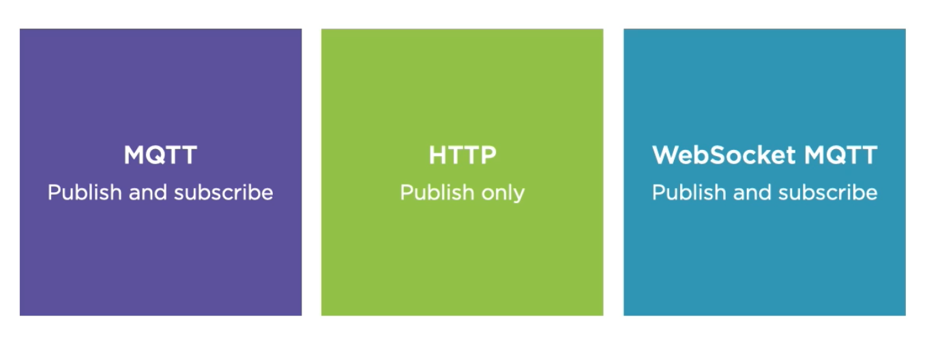
AWS solutions -Message broker protocols

Slide 26
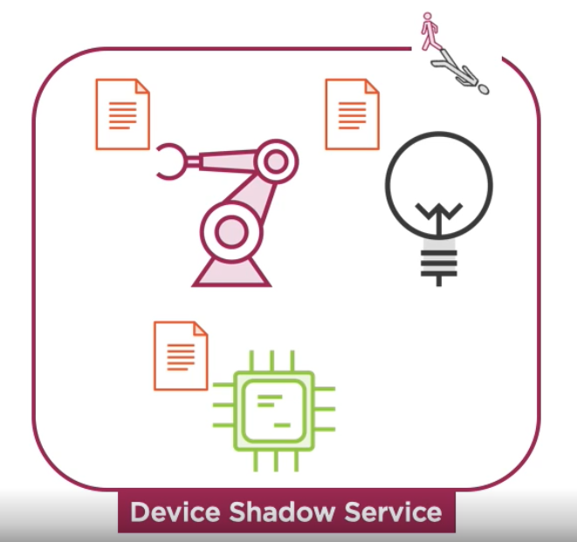
AWS solutions -Device Shadow
‘A JSON document that is used to store and retrieve current state information for a device.’
‘Device Shadow Service maintains a shadow for each device connected to AWS IoT.’

Slide 27
AWS solutions -Device Shadow
When you retrieve a device shadow in your application, that means that AWS reported a state of your device to you, but, that is not the only thing you can do. You can also change device shadow, and bring back a document to a service.
There are some variants:
Accept change, then update document
Update document, no matter if the change is accepted
Etc…

Slide 28
AWS solutions -Rules Engine
‘A component of AWS IoT that allows you to filter data from IoT topics, transform the data, and send it along to other AWS and non-AWS services.’
IoT rule query statement is very similar to SELECT clausule in SQL.
In addition to retrieving the data which satisfies the query statement, you can also add an action to be performed immediately after retrieving it.

Slide 29
AWS solutions -Rules Engine
The actions can be:
direct integrations with AWS services (send data to Amazon S3 or DynamoDB, send data as parameter in AWS Lambda Function)
direct integrations with non-AWS services (use AWS Lambda to push data to third party APIs)
integrations with AWS services via other AWS services
integrations with non-AWS services via other AWS services

Slide 30
AWS solutions -AWS IoT Analytics
‘A fully-managed service that makes it easy to run and operationalize sophisticated analytics on massive volumes of IoT data.’
Two steps:
Preparing the data (using channels, pipelines, data stores)
Analyzing of data (using data sets and notebooks)

Slide 31
AWS solutions -AWS IoT Analytics
First station where data is coming is an IoT Analitycs channel. Channel has a few pieces of configuration:
Configuring the channel as a target for an IoT rule (mentioned before) or configuring a rule as a source of the channel.
Configuring data retention settings – how long to keep data into the channel
Second station is an IoT Analytics pipline, configured with:
Configuring the source of the data – channel
Configuring the destination (where to send) – data store
Transformation activities- actions performed on data before sending to the data store

Slide 32
AWS solutions -AWS IoT Analytics
Transformation Activities:
Lambda Activity – customized function in many different programming language possibilities.
Device Registry Activity – using thing registry for finding information about device and perform action on it
Math Activity
Select/Filter Attributes (Select the input filter the output)
Device Shadow Activity (mentioned earlier)
Add/Remove Attributes

Slide 33
AWS solutions -AWS IoT Analytics
The next station from pipeline is data store.
Data store configuration:
data retention period
The analyze section will allow us to take a data store and turn it into the data set. When we have data sets, we can configure them with Amazon SageMaker Notebooks. That allows us to run variety of different code on the data we have including Python code inside of Jupiter Notebooks and other statistical programming languages

Slide 34
AWS solutions -AWS IoT Analytics
Data set configuration:
Setting up SQL query for turning data store into data set (potentially it can also be a modification, not only filtering)
Schedule – this is going to refresh the data periodically as it continues to stream in to the data store
Retention period
Notebooks configuration:
Template (depending on what we need notebook to do)
Input data set

Slide 35
AWS solutions -AWS IoT Analytics – Notebook templates
Amazon SageMaker contains templates for:
Anomaly detection
Output forecasting
Predictive Maintenance
Customer segmentation
Congestion forecasting
(everything based on ML)

Slide 36
AWS solutions -AWS IoT Events
‘A fully managed IoT service that makes it easy to detect and respond to events from IoT sensors and applications.’
Input to this service can be from different sources:
The output from IoT Analytics
IoT Things
IoT Events API
When the input is aggregated, it will define logic and states to detect events in data and take some sort of action

Slide 37
AWS solutions -AWS IoT Events
Triggered actions are calls to other AWS services, such as:
Lambda function (often used for customized code or calls of other AWS and non-AWS services)
Simple Notification Service

Slide 38
Thank you! ☺

